Slide 1


Chapter 9
Using MongoDB server for sharing and storing information

Slide 2
Learning objectives
1. What are non-relational or NoSQL databases in JSON format
2. How to create collections in a NoSQL database
3. How to insert/delete/update records in a NoSQL collection
4. How to connect to a NoSQL database server using node.js
5. How to manipulate NoSQL database using node.js

Slide 3
Emergence of NoSQL database models
COBOL
Relational database model
NoSQL

Slide 4
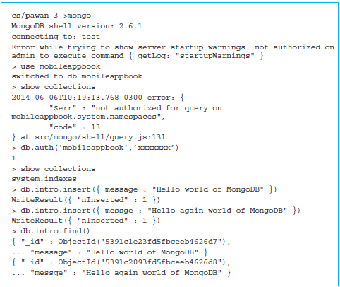
Introduction to MongoDB
Data in a MongoDB database is stored in a collection.
There is no intuitive graphical user interface (GUI) for MongoDB.
Use a command line interface (CLI)

Slide 5
Session for deleting documents and collections
Use the method remove() to delete documents from a collection.
Similar to the delete command in SQL.
Remove the document with spelling error:
> db.intro.remove({messge: "Hello again world of MongoDB"})
WriteResult({ "nRemoved" : 1 })
Delete a partcular document by specifying it as
{messge: “Hello again world of MongoDB”}.
Confirm that the document is gone from the collection.

Slide 6
A different version of the remove command
Regular expression referred to as $regex in MongoDB.
> db.intro.remove({messge:{$regex:''}})
WriteResult({ "nRemoved" : 1 })
Confirm that the documents are gone from the collection:
> db.intro.find()
{ "_id" : ObjectId("5391c1e23fd5fbceeb4626d7"),
... "message" : "Hello world of MongoDB" }
Empty an entire collection—that is, delete all the documents.
Use empty braces {} in the remove method.

Slide 7
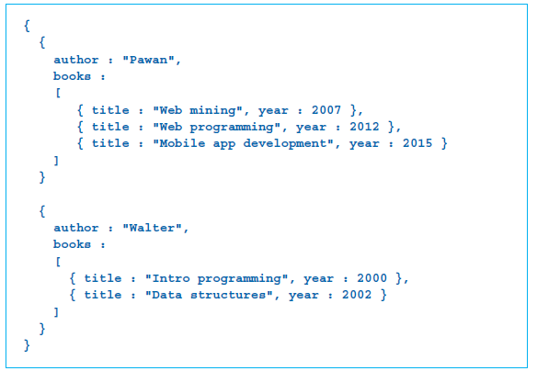
Modeling a NoSQL database
In figure below:
Each document has two attributes: author and books.
Each subdocument has two attributes: title and year.
Do not need to create the entire structure of the collection.

Slide 8
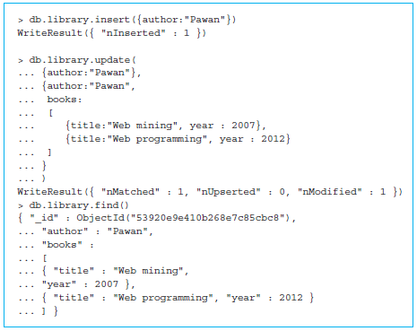
Implementation of the database model using MongoDB
Update an existing document with a method called update().
The method needs at least two parameters: a query to identify the document and the updated document.

Slide 9
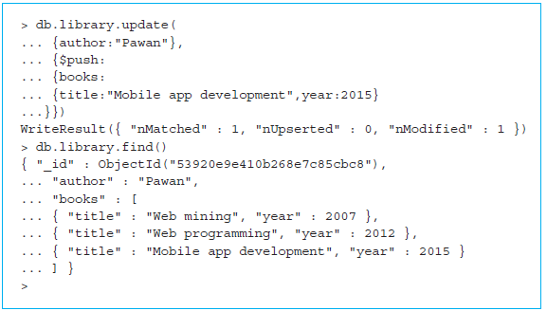
Pushing documents in an array in MongoDB
Find() method used to verify that the document is as we wanted it to be.
The update() command can build on the existing record instead of specifying a complete new copy of the record.

Slide 10
Aspects of the find() method
The find() method can accept a <query> such as shown in the following call:
db.library.find({author:"Walter"})
db.library.find({author:"Walter"},{books:1})
Our projection {books:1} specifies that we want the attribute books by putting the digit 1 against it.

Slide 11
Modeling a NoSQL database for the Thyroid app
Create a database model for our server version of the Thyroid app.
Store fourteen attributes, such as email address, first name, etc.
Design a data model.
In a NoSQL database, the data modeling will consist of designing the structure of the collections.
Separate the collection into two collections.

Slide 12
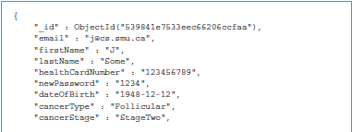
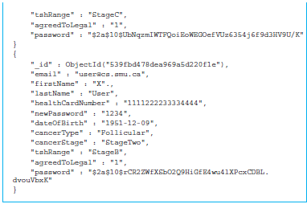
Users collection stored in our MongoDB database
MongoDB adds a unique _id attribute for each record.

Slide 13
Launching the MongoDB server for the Thyroid app
node server.js
Command node used to invoke the Node.js runtime environment, and we are passing the name of the file containing the script as a parameter.
Import the bcrypt module for encrypting the password.
Express module
Required on the database server to handle POST and GET requests from the browser.

Slide 14
Launching the MongoDB server for the Thyroid app (cont’d)
Method mongodb.connect()
The first parameter accepted is the connectionString that contains information for connecting to the MongoDB server such as the server IP address, port, username, and password.
The second parameter is the function that will be executed when we connect to MongoDB.
Launch the server using the method app.listen().

Slide 15
Saving a new user on the MongoDB server for the Thyroid app
Running the method app.post()
If any of the data that is required to create a new user is null, we return the response with error code 400 and a message saying that login information is missing.
Encrypt the password before storing it in the database.
Generate a string called salt.
The salt string is added to the password string before encryption, making it difficult for attacks that could try a list of password guesses such as dictionary words.

Slide 16
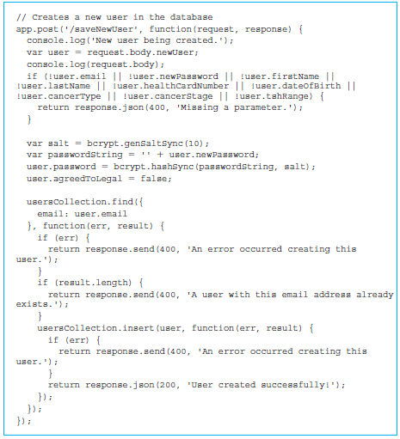
Saving a new user on the MongoDB server for the Thyroid app (cont’d)

Slide 17
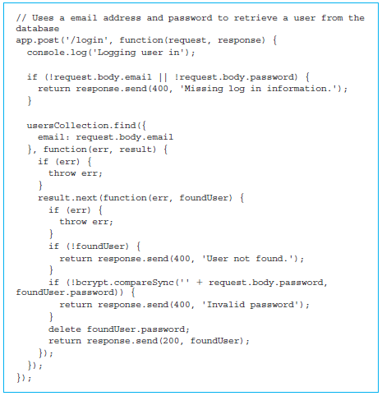
Processing login with the MongoDB server for the Thyroid app
Method app.post() receives two parameters:
The first one is the request ‘/login’, which will be handled by the server.
The second parameter is an anonymous function that contains the rest of the code.

Slide 18
Updating user data in the MongoDB server for the Thyroid app
Running the method app.post(), which receives two parameters:
The first is the request ‘/updateUser’,
The second is an anonymous function that contains the rest of the code.
No need to encrypt the entered password.
The update function takes four parameters.
The first is a JSON object with an email field equal to the email value we received through the request.body or user.
The second is the entire user object
The third parameter can be used to specify a number of options that can be specified.
The fourth is an anonymous function that takes one parameter called err.

Slide 19
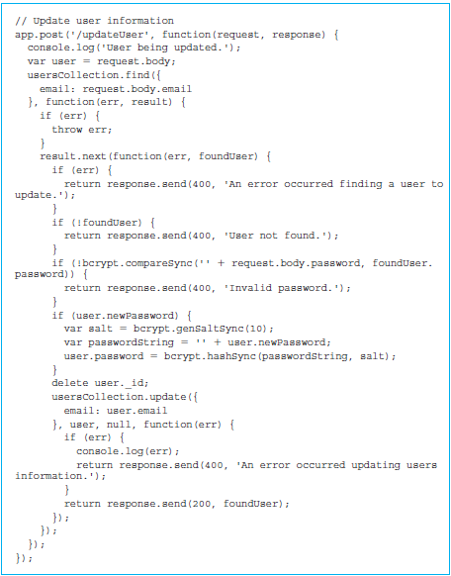
Updating user data in the MongoDB server for the Thyroid app (cont’d)

Slide 20
Downloading records from the MongoDB server for the Thyroid app
Processing a getRecords request.
Running the method app.post(), which receives two parameters:
the request ‘/getRecords’
an anonymous function that contains the rest of the code
Get the records for the user using the method getRecords().

Slide 21
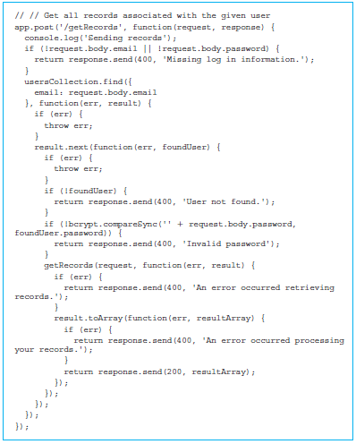
Downloading records from the MongoDB server for the Thyroid app (cont’d)

Slide 22
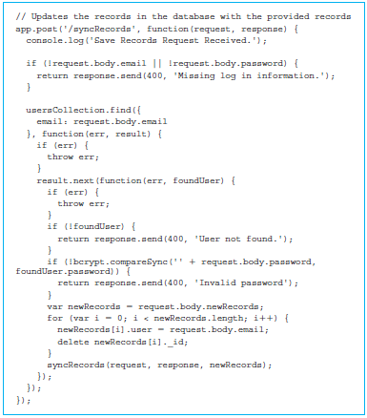
Uploading records to the MongoDB server for the Thyroid app

Slide 23
Uploading records to the MongoDB server for the Thyroid app (cont’d)
Running the method app.post(), which receives two parameters:
the request ‘/syncRecords’
an anonymous function that contains the rest of the code
Return the response with error code 400 if either the email or password in the request body is empty.
Look at the MongoDB usersCollection using the find() method.
Check to see if the foundUser is null.

Slide 24
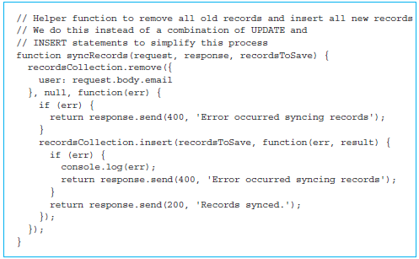
Uploading records to the MongoDB server for the Thyroid app (cont’d)
Do a little bit of cleanup of the records that we received through the request body by first assigning request.body.newRecords to a variable called newRecords.
Function syncRecords() performs two operations on the recordsCollection.
Add the new records received through the parameter recordsToSave using the recordsCollection.insert() method.

Slide 25
Quick facts/buzzwords
NoSQL
MongoDB
mongo
use
show collections
insert()
update()
remove()
find()
drop()
db.auth()

Slide 26
Quick facts/buzzwords (cont’d)
Database modeling
bcrypt
CORS
process.on()
listen()
genSaltSync()
hashSync()
compareSync()

